Slide 1
Interactive Jobs
Vuong Tran

Slide 2
Content
Augmented Reality introduction
Interactive Job Application
Q&A

Slide 3

AUGMENTED REALITY INTRODUCTION
Notes:
Firstly, i want to show all of you, a very cool technology, augmented reality. This technology is not new but has not popular yet.

Slide 4
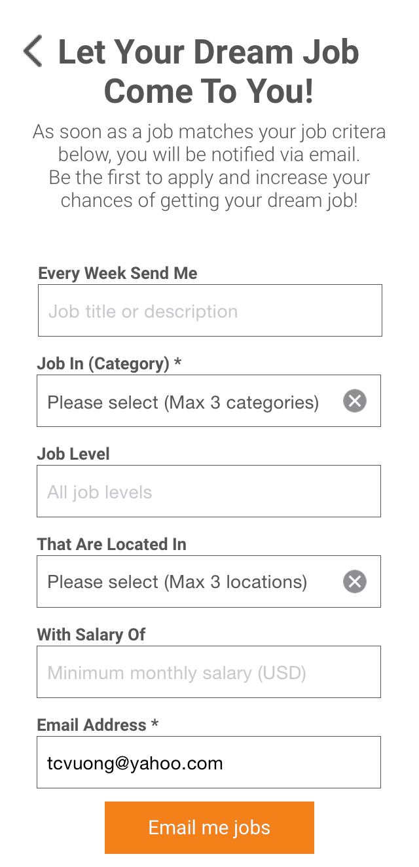
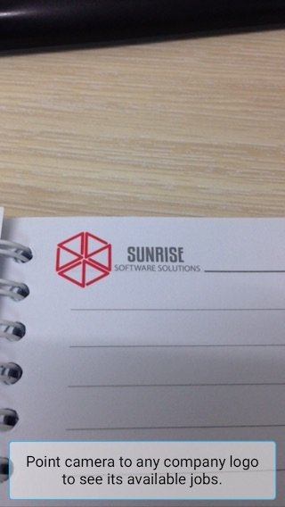
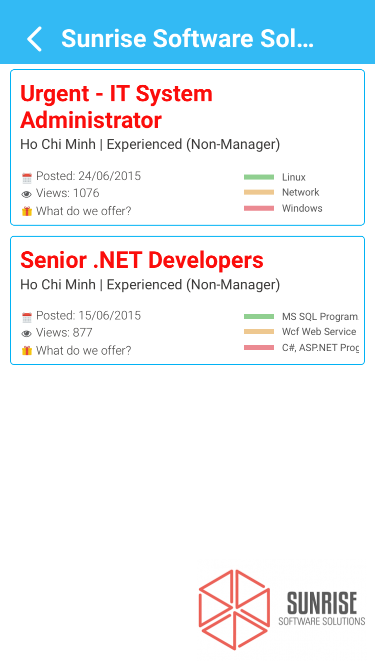

INTERACTIVE JOB APPLICATION
Notes:
This is some screen of the application, its not all but the main screens.
First is main screen and also the main function of this application. This screen will use the device’s camera, you can move the camera to the thing that you want to recognized maybe it is a company logo, company entrance or anything.
The second main screen is the result screen where it show all jobs which available for the thing that you search on the first screen, it will list all jobs of a company, jobs in a building, or job related to a item.
The login screen with two main feature, login with Facebook or linked in, we has not do much with the information we get from Facebook or linked in but if we are intent to expand this app further, we will use those information maybe for narrow down the result jobs to match with each person proflle.
The next screen is a alert me feature which can send email to user when there a jobs that they need available.

Slide 5

MAIN FEATURES
Search jobs with company logos

Slide 6

MAIN FEATURES
Search jobs with buildings

Slide 7
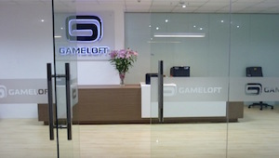
MAIN FEATURES
Search jobs with company entrances

Slide 8
MAIN FEATURES
Search history
Show company information
Job Alert subscription

Slide 9
Supported companies and buildings
Atlassian
Etown building
FPT Software
GameLoft
GlassEgg
HoangAnhGiaLai building
MeCorp
S3Corp
Vinmart
Vitalify Asia

Slide 10
Supported company logos
CSC
Trente
Swiss
Viettel
Mobifone
Amway
Fujinet
Sshin
…

